Slide 1

Region & Education as Predictors of Changes in Mean Depression
An Analysis of NHIS Survey Data

Slide 2
Abstract
This analysis aims to examine the relationships among region, educational attainment, and depression levels, as indicated by the PHQ scale. I hypothesized that: 1) living in metropolitan regions would be associated with higher levels of depression; 2) having higher levels of educational attainment would predict lower levels of depression; 3) educational achievement would moderate the relationship between region and depression such that individuals in non-metropolitan regions would have lower levels of depression. A multiple regression analysis was used to assess this relationship, using mean PHQ scores as the outcome variable, educational attainment as a predictor, and region as a nominal predictor. In contrast to expectations, living in non-metropolitan regions was associated with higher levels of depression than living in metropolitan regions. Also, higher levels of education were associated with higher levels of depression. However, an interaction effect revealed that educational achievement moderated mean depression scores such that individuals living in smaller metropolitan areas or non-metropolitan areas were more likely to have lower levels of depression when educational attainment was higher. Although not entirely in line with expectations, these results may have implications regarding the importance of providing mental health care for individuals in non-metropolitan regions. Also, the results may have implications for the role of education in moderating depression in smaller metropolitan regions. Of course, none of the findings provided in this analysis are causal in nature.

Slide 3
Overview
Many have questioned the role of living conditions on mental health
For instance, Calhoun and colleagues (1962) performed an infamous study on a rodent colony examining the effects of overcrowded conditions on behavior
Found that rodents exhibited erratic, violent, and disturbing behavior as a result of their conditions
Many researchers have attempted to extend results to humans
Examine the role of busy, crowded, city life on mental health conditions
Most research has been observational in nature
Inconclusive findings

Slide 4
Overview
The role of education has also been examined with regards to mental health outcomes
For instance, a meta-analysis performed by Huang et al. (2010) found that older adults with greater educational attainment had a lower risk of depression than those with lower educational attainment

Slide 5
Overview
This analysis aims to examine the relationships among regional differences, educational attainment, and levels among adults aged 26-36
Data were drawn from an NHIS survey conducted in 2022
survey and questionnaire data detailing demographic and mental/physical health data for individuals in the US

Slide 6
Independent Variables
Region (measured nominally)
Levels:
Large Central Metropolitan
Contain 1 million+ residents, and are considered the largest principle city
Large Fringe Metropolitan
Metropolitan regions do not meet the criteria for being large central
Medium and Small Metropolitan
Contain 250,000-999,000 residents
Non-Metropolitan
Do not meet the above criteria and are defined as micropolitan
Educational Attainment (ordinal)
Levels:
1st Grade – 11th Grade
Did not complete K-12 schooling
High School
Completed a high school education
Bachelor
Completed undergraduate education
Graduate/Post-Graduate
Completed graduate or post-graduate education

Slide 7
Dependent Variable
Depression (Interval)
Measured by the PHQ Scale
Eight item scale that assesses symptoms of depression
Calculated the mean of the eight items

Slide 8
Research Question
Three Hypotheses:
living in metropolitan regions would be associated with higher levels of depression
having higher levels of educational attainment would predict lower levels of depression
educational achievement may moderate the relationship between region and depression such that individuals in non-metropolitan regions would have lower levels of depression

Slide 9
Method
A Multiple Regression analysis will be used to assess effects
Mean PHQ depression scores will serve as the outcome variable
Region will serve as a nominal predictor
Treated as a factor: dummy coded into three categories, with one reference level (large central metropolitan)
Educational attainment will serve as a predictor
Treated as numeric, since it is ordinal

Slide 10
Summary Statistics (Depression)
Mean scores ranged from 1 – 4
The overall mean of the aggregated scores was 1.35
As we will see in the next slides, depression scores are heavily positively skewed
As a result, I will be using a power analysis to normalize the data

Slide 11
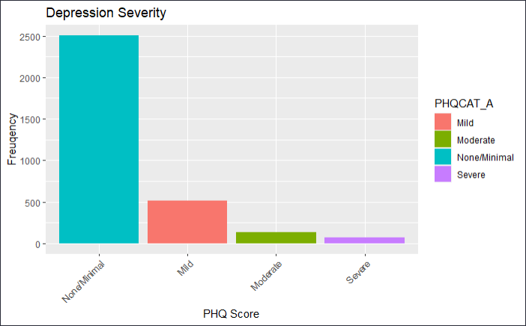

Slide 12
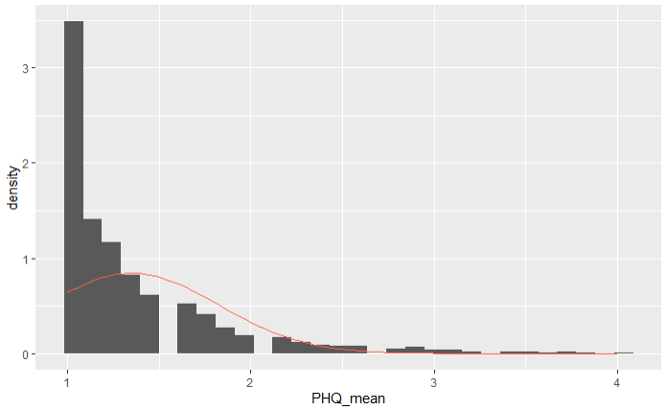

Slide 13
Summary Statistics (Region)
Region | Count | Proportion
Large central metro | 1281 | 0.3965944
Large fringe metro | 721 | 0.2232198
Medium and small metro | 877 | 0.2715170
Non-metro | 351 | 0.1086687

Slide 14
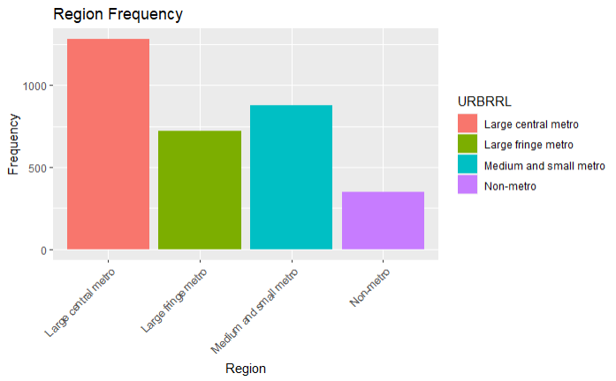

Slide 15
Summary Statistics (Educational Attainment)
Educational Attainment | Count | Proportion
1st - 11th Grade | 175 | 0.0541796
High School | 938 | 0.2904025
Bachelors | 1410 | 0.4365325
Graduate/Post-Graduate | 707 | 0.2188854

Slide 16
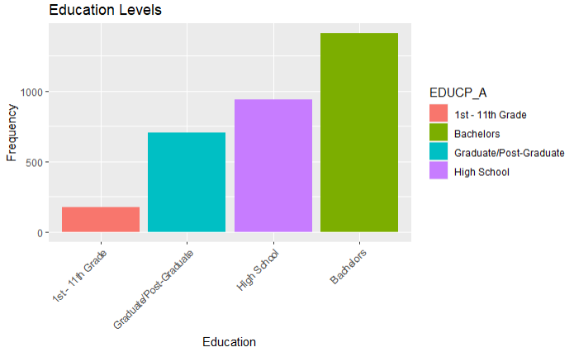

Slide 17
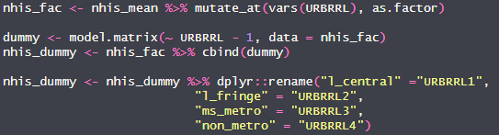
Dummy Coding
To analyze regional differences, I used the following syntax to create dummy variables for each condition
For the purposes of this analysis, the large central region condition was used as the reference group

Slide 18
Power Transformation
To account for the potential of skewness, a power transformation was performed prior to the multiple regression analysis:
Unfortunately, this power transformation did not completely normalize the residuals, as we will see

Slide 19
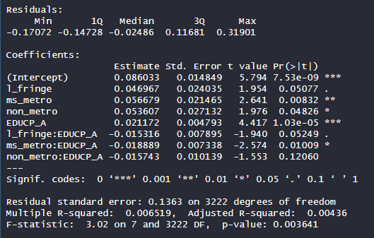
Results
Interpretation:
The model is significant at the p < .01 level
However, the Adjusted R² is rather low
0.004
This indicates that this model may be a poor fit for these data, as the model is currently only accounting for less than 1% of the variance

Slide 20
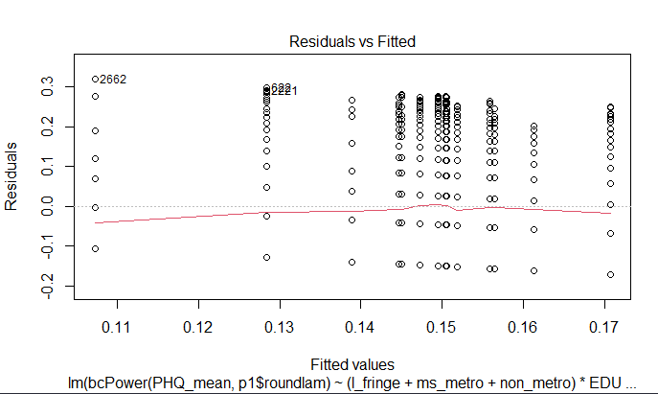
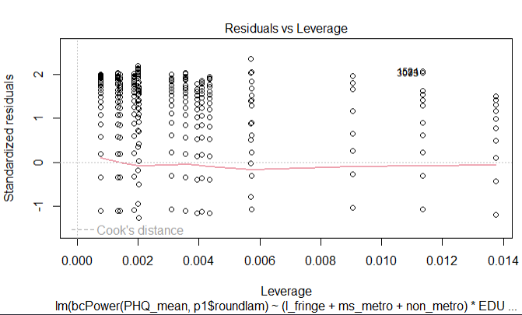
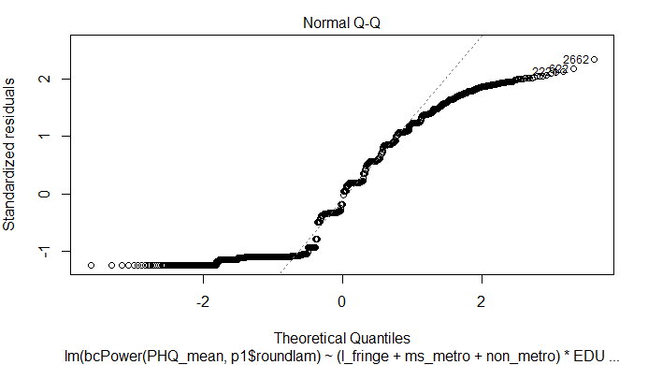

Slide 21
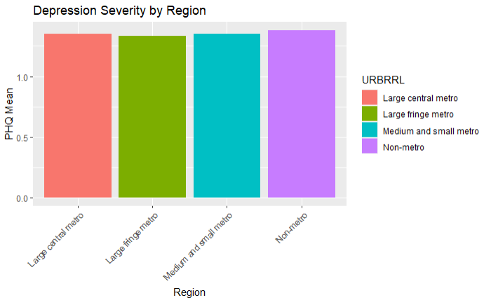
Region | Mean PHQ Score
Large central metro | 1.350312
Large fringe metro | 1.336165
Medium and small metro | 1.352765
Non-metro | 1.380342

Slide 22
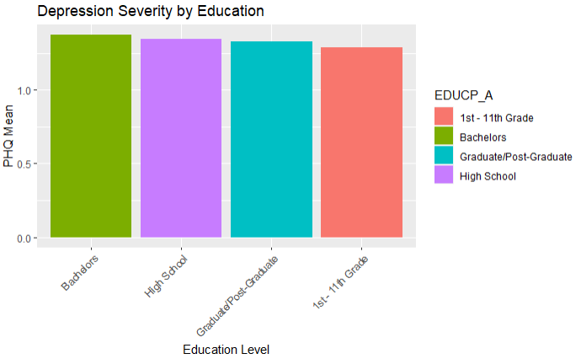
Educational Attainment | Mean PHQ Score
1st - 11th Grade | 1.290000
High School | 1.346482
Bachelors | 1.373227
Graduate/Post-Graduate | 1.328147

Slide 23
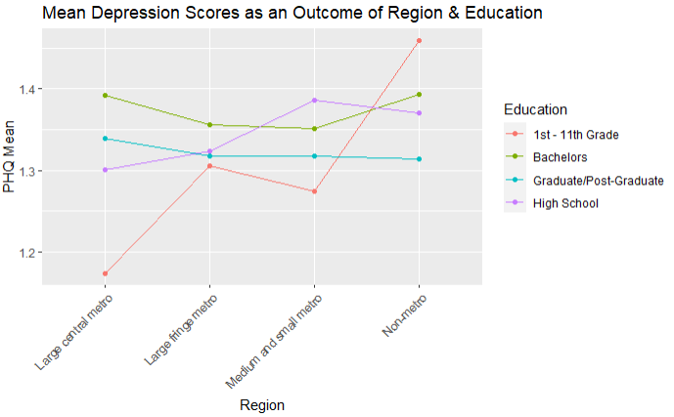

Slide 24
Conclusions
This model was significant at the p < .01 level
Unfortunately, this model is a poor fit for these data
Adjusted R² = .004

Slide 25
Conclusions
Hypothesis 1: Not supported
Living in large metro areas was not associated with higher mean depression
In fact, it was associated with lower mean depression
Hypothesis 2: Not supported
Higher levels of education were not associated with lower mean depression
In fact, higher levels of education were associated with higher mean depression
Hypothesis 3: Partially supported
Educational attainment moderated the relationship between region and mean depression
Higher education associated with lower mean depression in large fringe metro areas compared to large central metro areas

Slide 26
Conclusions
Results stand in contrast with the notion that busy, crowded areas correspond with mental health difficulties
May also stand in contrast with the notion that higher education corresponds with better mental health outcomes
Results may highlight the importance of pursuing higher education in smaller regions

Slide 27
Conclusions
These findings may suggest that more mental health initiatives should be implemented in smaller, less centralized regions
May also underscore the need to look out for the mental health of individuals who have pursued higher education
Of course, due to the observational nature of this analysis, no causal conclusions can properly be drawn

Slide 28
Limitations
This model was a poor fit for the data used in this analysis
Which most certainly limits the inferences that can be drawn
The analytic sample was composed of individuals aged 26-36
Different effects may be seen for different age groups
The analysis was limited to depression as the only mental health outcome
Other psychopathologies, such as anxiety or schizophrenia, were not tested
Other extraneous variables that were not tested may better explain any relationships shown in this analysis

Slide 29
Suggestions for Future Research
Future analyses can:
Examine the effects of potential covariates
Such as household income, gender, comorbid diagnoses
Use more robust statistical models
Such as Robust Regression
Use alternative analytic approaches
Such as the Kruskal-Wallis ANOVA to test for mean differences

Slide 30
References
Bauldry, S. (2015). Variation in the protective effect of higher education against depression. Society and mental health, 5(2), 145-161.Calhoun, J. B. (1962).
Population density and social pathology. *Scientific American*, 206(2), 139-149.Centers for Disease Control and Prevention. (2017, June 1). Data Access - Urban Rural classification scheme for Counties. Centers for Disease Control and Prevention. https://www.cdc.gov/nchs/data_access/urban_rural.htm
Chang-Quan, H., Zheng-Rong, W., Yong-Hong, L., Yi-Zhou, X., & Qing-Xiu, L. (2010). Education and risk for late life depression: a meta-analysis of published literature. The International Journal of Psychiatry in Medicine, 40(1), 109-124.
National Center for Health Statistics. (2022). Center for Disease Control and Prevention. https://www.cdc.gov/nchs/nhis/2022nhis.htm
powerTransform function - RDocumentation. (n.d.). https://www.rdocumentation.org/packages/car/versions/2.1-4/topics/powerTransform

